Slide 1




Distributed Web Security for Science Gateways
Jim Basney jbasney@illinois.edu
In collaboration with: Rion Dooley dooley@tacc.utexas.edu
Jeff Gaynor gaynor@illinois.edu
Suresh Marru smarru@indiana.edu
Marlon Pierce marpierc@indiana.edu
This material is based upon work supported by the National Science Foundation under grant number 1127210.

Slide 2
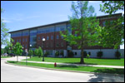
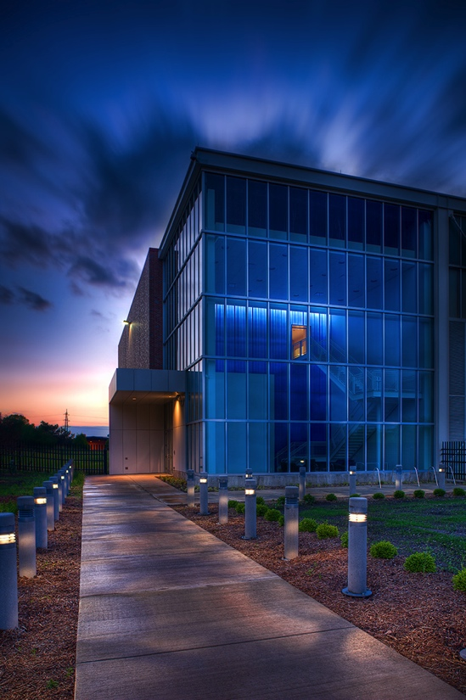
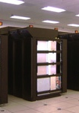
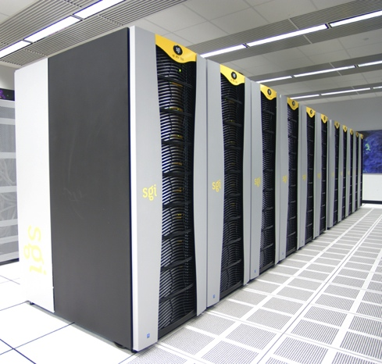
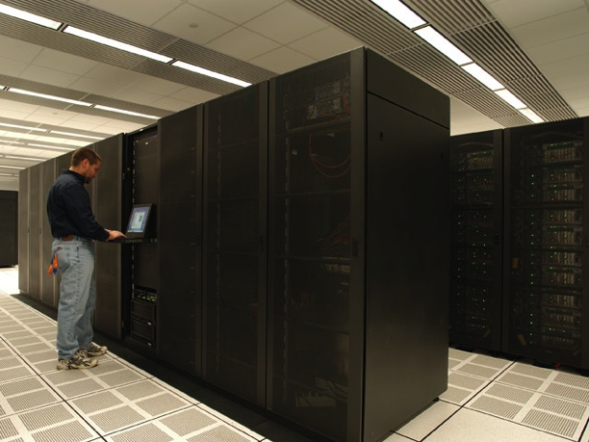
National Center for Supercomputing Applications (NCSA)
Located at University of Illinois at Urbana-Champaign
Established in 1986 by NSF Supercomputer Centers Program
www.ncsa.illinois.edu

Slide 3

Distributed Web Security for Science Gateways
Software Development for Cyberinfrastructure grant from the NSF Office of CyberInfrastructure (www.nsf.gov/oci)
3 year project: August 2011 – July 2014
Co-PIs: Marlon Pierce (IU), Rion Dooley (TACC)
What is cyberinfrastructure?
Supercomputers, mass-storage systems, data repositories, networks, software and more
Supporting science and engineering research and education

Slide 4
Motivating Example: Photo Printing
2
3
Your flickr
Password
Photos
1
Your flickr Password

Slide 5
Defining Terms
Authentication: Who are you?
customer #83461234987
name: Jim Basney
email: jbasney@illinois.edu
Authorization: What are you allowed to do?
Access private information
Charge purchases to your credit card
Delegated Authorization: Authorizations you grant to others
Park your car (valet key)
View your photos on Flickr
Collaboratively edit an online Google doc
Credential: How security information is conveyed
Also known as Assertion or Token

Slide 6
Delegated Authorization
Authenticate & Grant Access to Photos
2
3
Token
5
6
Token
Photos
4
Token
1
Request Access to Photos

Slide 7

OAuth
An open protocol for delegated authorization (oauth.net)
Development
OAuth 1.0 released (October 2007)
OpenID+OAuth hybrid developed (2009)
OAuth 1.0a revision (June 2009)
RFC 5849 (Informational), April 2010
OAuth WRAP (2009-2010)
Basis for OAuth 2.0
OAuth 2.0 Standards Track RFC coming soon
OpenID Connect based on OAuth 2.0
Used by Flickr, Twitter, Facebook, Google, Netflix, …

Slide 9
OAuth 1.0 Model
Server
Authenticate & Grant Access
2
Resource Owner
Token
3
5
6
Token
Resource
4
Token
Client
1
Request Access

Slide 10
OAuth 2.0 Model
Validate Token
Authorization Server
Resource Server
6
2
Authenticate & Grant Access
Resource Owner
Token
3
5
8
7
Token
Token Refresh
Resource
4
Token
Client
1
Request Access

Slide 15
Authentication Model
Identity Provider
Authenticate
2
User
Assertion
3
5
6
Assertion
User Information
4
Assertion
App
1
Who are you?
Examples: OpenID, SAML

Slide 16
Authentication Via Delegation
Identity/Resource Provider
Authenticate & Grant Access to My Info
2
Resource Owner
Token
3
5
6
Token
User Information
4
Token
App
1
Who are you?
Example: OpenID Connect

Slide 17
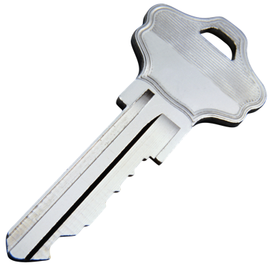
Authentication Via Delegation
Bad Idea
App: Who are you?
User: Here’s full access to my Twitter account.
Better Idea
App: Who are you?
User: Here’s read access to my Twitter account profile.
Delegated access to user’s profile information
http://nat.sakimura.org/2011/05/15/dummys-guide-for-the-difference-between-oauth-authentication-and-openid/
Example: OpenID Connect built on OAuth

Slide 18
OAuth 1.0 Model (Again)
Server
Authenticate & Grant Access
2
Resource Owner
Token
3
5
6
Token
Resource
4
Token
Client
1
Request Access

Slide 19
External Authentication
AuthN Service
2b
Verify Password
Resource Owner
2a
Server
Password
Client
Examples: LDAP, RADIUS, PAM, Kerberos

Slide 20
Token-based Authentication
IdP
Password
2b
Assertion
2c
User Attributes
2d
2d
Assertion
Resource Owner
Server
2a
Who are you?
Client
Examples: OpenID, SAML, Kerberos

Slide 21
Science Gateways
Notes:
UltraScan: modeling analytical ultracentrifugation sedimentation experiments

Slide 22
Notes:
Allows researchers and students to use computational chemistry applications without being supercomputer experts, by providing a web interface and desktop client. User builds a molecule for simulation, and GridChem computes a molecular animation.

Slide 23
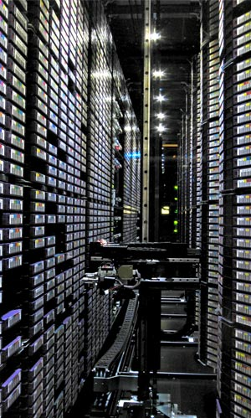
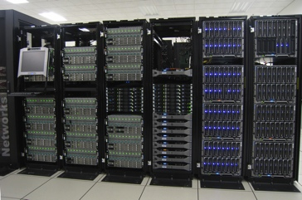
Science Gateways: Accessing Resources
user accesses science gateway
science gateway uses external resources (supercomputers, compute clusters, data stores)

Slide 24
Science Gateways: Tiered Access Models
user authenticates to science gateway
science gateway authenticates to service providers

Slide 25
Science Gateways: Tiered Access Models
Option A: Transitive Trust
Bilateral agreement between science gateway & service provider
Bulk allocation of service to the science gateway
Service provider may not know who the end users are
Users may not know who the underlying service providers are
Option B: Delegation of Rights
End user has account at underlying service provider
Goal: Use underlying services via science gateway interfaces
Science Gateway explicitly acts on the user’s behalf when interacting with the underlying service providers
Both options are useful
Today let’s focus on Option B: Delegation of Rights

Slide 26
Motivating Example: Science Gateway
2
3
Your
Password
Access
1
Your Password

Slide 27
Delegated Authorization via OAuth
Authenticate & Grant Access
2
3
Token
5
6
Token
Access
4
Token
1
Request Access to Supercomputer

Slide 28
Challenge: Multi-Tier Science Gateways
Science Gateway
Web Browser
Gadget Container
Gadget Backing Service
Service Factory
Service Factory
…
External Services
Data Store
Info Service
Compute Cluster
…
…

Slide 29
Long-Running Science Gateway Workflows
Common Science Gateway Use Case:
Scientist launches workflow (computational simulation, data analysis, data movement/replication, visualization)
Workflow runs for hours/days/weeks
Scientist monitors workflow / receives notifications of completion
Challenge: Duration of Delegation
“How long can the science gateway act on my behalf?”
Ideally: only as needed for the workflow to complete
Limit duration of delegation to minimize window of exposure
Difficult / inconvenient to predict workflow duration
Approaches: refresh / renewal / revocation
OAuth 2.0 refresh is needed!

Slide 30

Globus Online Example
Kerberos Authentication Server

Slide 31
Back-end Authentication (Again)
AuthN Service
2b
Verify Password
Resource Owner
2a
Server
Password
Client

Slide 34
Globus Online Example

Slide 36
Globus Online Example
Kerberos Authentication Server

Slide 38
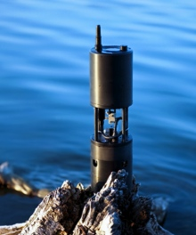
OOI Example

Slide 39
Token-based Authentication (Again)
IdP
Password
2b
Assertion
2c
User Attributes
2d
2d
Assertion
Resource Owner
Server
2a
Who are you?
Client

Slide 41
OOI Example

Slide 43
OOI Example

Slide 45

OOI Example

Slide 47
Wrap Up
Thanks for your interest!
More info
www.sciencegatewaysecurity.org
jbasney@illinois.edu
References
Jim Basney, Rion Dooley, Jeff Gaynor, Suresh Marru, and Marlon Pierce, "Distributed Web Security for Science Gateways," Gateway Computing Environments Workshop (GCE11), November 17, 2011, Seattle, WA.
Jim Basney and Jeff Gaynor, "An OAuth Service for Issuing Certificates to Science Gateways for TeraGrid Users," TeraGrid Conference, July 18-21, 2011, Salt Lake City, UT. http://dx.doi.org/10.1145/2016741.2016776
Jim Basney, Von Welch, and Nancy Wilkins-Diehr, "TeraGrid Science Gateway AAAA Model: Implementation and Lessons Learned," TeraGrid Conference, August 2-5, 2010, Pittsburgh, PA. http://dx.doi.org/10.1145/1838574.1838576
Von Welch, Jim Barlow, James Basney, Doru Marcusiu, Nancy Wilkins-Diehr, "A AAAA model to support science gateways with community accounts," Concurrency and Computation: Practice and Experience, Volume 19, Issue 6, March 2007. http://dx.doi.org/10.1007/s10586-007-0033-8

